Slide 1
Database Management Systems LECTURE 8 Relational algebra
IITU, ALMATY, 2020

Slide 2
Link to the Video
https://youtu.be/kOIQHNZl2vk

Slide 3
Querying Data From Tables
Query operations facilitate data retrieval from one or more tables.
The result of any query is a table. The result can be further manipulated by other query operations.
Syntax:
SELECT attribute(s)
FROM table(s)
WHERE selection condition(s);

Slide 4
Review of last lecture
The operations of Relational algebra:
projection
selection
union
difference
intersection

Slide 5
Join
The join operation enables querying information from two or more related tables.
It is similar to a selection condition except that values in two different tables are compared.
The most common form of a join is an equi-join. An equi-join combines two or more tables based on the tables’ primary and foreign keys.

Slide 6
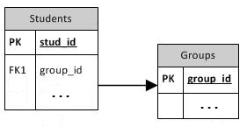
Join: example 1
CREATE TABLE Groups (
group_id int PRIMARY KEY,
group_name varchar(15));
CREATE TABLE Students (
stud_id int PRIMARY KEY,
first_name varchar(20),
last_name varchar(20),
bdate date,
group_id int REFERENCES Groups(group_id));

Slide 7
Join: example 1
SELECT stud_id, last_name, group_name
FROM Students, Groups
WHERE
Students.group_id = Groups.group_id;
stud_id | last_name | group_name
… | … | …
… | … | …

Slide 8
table.column format
The table.column format used in the above selection condition.
This syntax is used to resolve naming conflicts if fields in the tables have the same name.
This syntax may be used in the SELECT clause or WHERE clause.

Slide 9
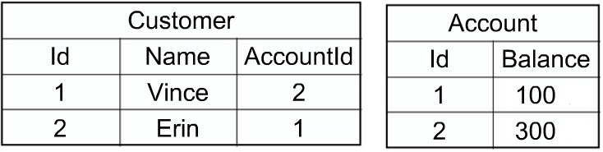
Join: example 2
CREATE TABLE Account (
id int PRIMARY KEY,
balance int);
CREATE TABLE Customer (
id int PRIMARY KEY,
name varchar (20),
accountid int REFERENCES Account (id));

Slide 10
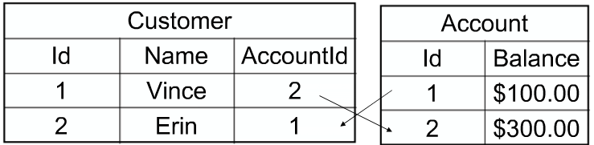
Join: example 2
Suppose we want to query the name of the Customer who has Balance = 100$.
We can do this by joining the Account and Customer tables where they are equal – where the FK of Customer (AccountId) is equal to the PK of the Account (Id).

Slide 11
Join: example 2
The SQL query is:
SELECT name
FROM Customer, Account
WHERE
Customer.accountid = Account.id AND Account.Balance =100;

Slide 12
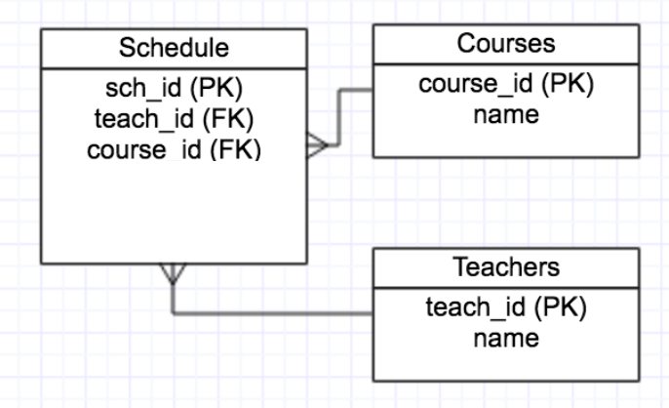
Join: example 3

Slide 13
Join: example 3
CREATE TABLE Courses (
course_id int PRIMARY KEY,
name varchar(30));
CREATE TABLE Teachers (
teach_id int PRIMARY KEY,
name varchar (30));
CREATE TABLE Schedule (
sch_id int PRIMARY KEY,
course_id int REFERENCES Courses (course_id),
teach_id int REFERENCES Teachers (teach_id));

Slide 14
Join: example 3
course_name | teach_name
… | …
… | …
SELECT Courses.name, Teachers.name
FROM Courses, Teachers, Schedule
WHERE
Courses.course_id = Schedule.course_id AND
Teachers.teach_id = Schedule.teach_id;

Slide 15
JOIN keyword
An SQL JOIN clause is used to combine rows from two or more tables.
Types:
INNER JOIN
OUTER JOIN
LEFT JOIN
RIGHT JOIN
FULL JOIN
CROSS JOIN

Slide 16
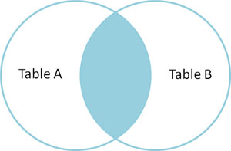
INNER JOIN
The most common type of join is SQL INNER JOIN (simple join).
An SQL INNER JOIN return all rows from multiple tables where the join condition is met.
Syntax:
SELECT column_name(s)
FROM tableA
INNER JOIN tableB
ON tableA.column_name = tableB.column_name;
INNER JOIN is the same as JOIN.

Slide 17
INNER JOIN: example
SELECT Students.stud_id, Students.fname, Groups.group_name
FROM Students
INNER JOIN Groups
ON Students.group_id = Groups.group_id;
The following example is equivalent to the previous one:
SELECT Students.stud_id, Students.fname, Groups.group_name
FROM Students, Groups
WHERE Students.group_id = Groups.group_id;

Slide 18
INNER JOIN: example
Students
stud_id | fname | group_id
1 | Boris | 2
2 | Beksultan | 2
3 | Aynur
Result table for INNER JOIN
stud_id | fname | group_name
1 | Boris | CSSE-124
2 | Beksultan | CSSE-124
Groups
group_id | group_name
1 | CSSE-122
2 | CSSE-124

Slide 19
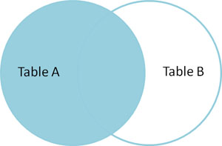
LEFT JOIN
The LEFT JOIN keyword returns all rows from the left table (tableA), with the matching rows in the right table (tableB). The result is NULL in the right side when there is no match.
Syntax:
SELECT column_name(s)
FROM tableA
LEFT JOIN tableB
ON tableA.column_name = tableB.column_name;
In some databases LEFT JOIN is used only like LEFT OUTER JOIN.

Slide 20
LEFT JOIN: example
The following SQL statement will return all students, and groups they might have:
SELECT Students.stud_id, Students.fname, Groups.group_name
FROM Students
LEFT JOIN Groups
ON Students.group_id = Groups.group_id;
The LEFT JOIN keyword
returns all the rows from
the left table (Students),
even if there are
no matches in the
right table (Groups):
Result table for LEFT JOIN
stud_id | fname | group_name
1 | Boris | CSSE-124
2 | Beksultan | CSSE-124
3 | Aynur

Slide 21
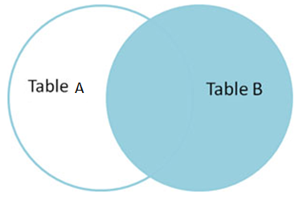
RIGHT JOIN
The RIGHT JOIN keyword returns all rows from the right table (tableB), with the matching rows in the left table (tableA). The result is NULL in the left side when there is no match.
Syntax:
SELECT column_name(s)
FROM tableA
RIGHT JOIN tableB
ON tableA.column_name=tableB.column_name;
In some databases RIGHT JOIN is used only like RIGHT OUTER JOIN.

Slide 22
RIGHT JOIN: example
The following SQL statement will return all groups, and students they might have:
SELECT Students.stud_id, Students.fname, Groups.group_name
FROM Students
RIGHT JOIN Groups
ON Students.group_id = Groups.group_id;
The RIGHT JOIN
keyword returns all
the rows from the right
table (Groups), even if
there are no matches
in the left table (Students):
Result table for RIGHT JOIN
stud_id | fname | group_name
1 | Boris | CSSE-124
2 | Beksultan | CSSE-124
 |  | CSSE-122

Slide 23
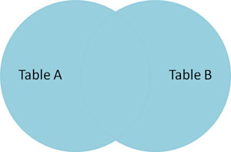
FULL OUTER JOIN
The FULL OUTER JOIN keyword returns all rows from the left table (tableA) and from the right table (tableB).
The FULL OUTER JOIN keyword combines the result of both LEFT and RIGHT joins.
Syntax:
SELECT column_name(s)
FROM tableA
FULL OUTER JOIN tableB
ON tableA.column_name=tableB.column_name;

Slide 24
FULL JOIN: example
The following SQL statement selects all students and all groups:
SELECT Students.stud_id, Students.fname, Groups.group_name
FROM Students
FULL OUTER JOIN Groups
ON Students.group_id = Groups.group_id;
The FULL OUTER JOIN keyword returns all the rows from the left table (Students) and all the rows from the right table (Groups).
If there are rows
in "Students" that do not
have matches in “Groups",
or if there are rows in
“Groups" that do not have
matches in “Students",
those rows will be listed
as well:
Result table for FULL OUTER JOIN
stud_id | fname | group_name
1 | Boris | CSSE-124
2 | Beksultan | CSSE-124
3 | Aynur
 |  | CSSE-122

Slide 25
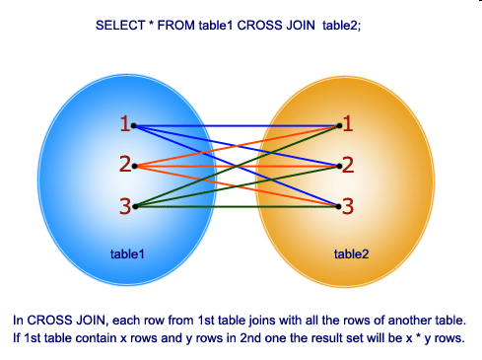
CROSS JOIN
“All-to-All”. The SQL CROSS JOIN produces a result set which is the number of rows in the first table multiplied by the number of rows in the second table. WHERE clause is not used along with CROSS JOIN. This kind of result is called as Cartesian Product.
SELECT *
FROM tableA
CROSS JOIN tableB;
or
SELECT *
FROM tableA, tableB

Slide 26
CROSS JOIN: example
SELECT *
FROM Students
CROSS JOIN Groups;
or
SELECT *
FROM Students, Groups;

Slide 27
CROSS JOIN: example
Result table for CROSS JOIN
stud_id | fname | group_id | group_id | Group_name
1 | Boris | 2 | 1 | CSSE-122
2 | Beksultan | 2 | 1 | CSSE-122
3 | Aynur |  | 1 | CSSE-122
1 | Boris | 2 | 2 | CSSE-124
2 | Beksultan | 2 | 2 | CSSE-124
3 | Aynur |  | 2 | CSSE-124

Slide 28
The complete JOIN syntax
SELECT Attribute(s)
FROM TableA
{INNER | {LEFT | RIGHT | FULL} OUTER | CROSS } JOIN TableB
ON <condition>

Slide 29
JOIN with USING
The USING clause is a shorthand that allows you to take advantage of the specific situation where both sides of the join use the same name for the joining column(s). It takes a comma-separated list of the shared column names and forms a join condition that includes an equality comparison for each one.
SELECT Attribute(s)
FROM TableA
{INNER | {LEFT | RIGHT | FULL} OUTER } JOIN TableB
USING (join column list)

Slide 30
JOIN with USING: example
SELECT *
FROM Students
INNER JOIN Groups
USING (group_id);
The output of JOIN USING suppresses redundant columns: there is no need to print both of the matched columns, since they must have equal values.

Slide 31
NATURAL JOIN
NATURAL is a shorthand form of USING: it forms a USING list consisting of all column names that appear in both input tables. As with USING, these columns appear only once in the output table.
SELECT Attribute(s)
FROM TableA
NATURAL
{INNER | {LEFT | RIGHT | FULL} OUTER } JOIN TableB

Slide 32
NATURAL JOIN: example
SELECT *
FROM Students
NATURAL INNER JOIN Groups;

Slide 33








Notation
The operations have their own symbols.
Operation | Symbol
Projection
Selection
Cartesian product
Join
Left outer join
Right outer join
Full outer join
Operation | Symbol
Union
Intersection
Set difference | -

Slide 34
Books
Connolly, Thomas M. Database Systems: A Practical Approach to Design, Implementation, and Management / Thomas M. Connolly, Carolyn E. Begg.- Fifth.- United States of America: Pearson Education, 2010
Garcia-Molina, H. Database system: The Complete Book / Hector Garcia-Molina.- 2.- United States of America: Pearson Prentice Hall, 2009
Sharma, N. Database Fundamentals: A book for the community by the community / Neeraj Sharma, Liviu Perniu.- First Edition.- Canada, 2010
www.postgresql.org/docs/manuals/
www.postgresql.org/docs/books/

Slide 35
Question
The SQL statement that queries or reads data from a table is ________ .
SELECT
READ
QUERY
None of these

Slide 36
Question
The result of a SQL SELECT statement is a(n) ________ .
Report
Form
File
Table

Slide 37
Question
Which of the following is the correct order of keywords for SQL SELECT statements?
a) SELECT, FROM, WHERE
b) FROM, WHERE, SELECT
c) WHERE, FROM,SELECT
d) SELECT,WHERE,FROM

Slide 38
Question
In an SQL SELECT statement querying a single table, the asterisk (*) means that:
all columns of the table are to be returned.
all records meeting the full criteria are to be returned.
all records with even partial criteria met are to be returned.
None of the above is correct.

Slide 39
Question
Which of the following SQL clauses specifies a search condition?
a) WHERE
b) SEARCH
c) WHILE
d) FROM

Slide 40
Question
Which of the following is used to denote the selection operation in relational algebra ?
a) Pi (Greek) b) Sigma (Greek) c) Lambda (Greek) d) Omega (Greek)

Slide 41
Question
Which product is returned in a join query have no join condition:
a) Equijoins
b) Cartesian
c) Both
d) None

